Slide 1
(1)
Pastor Gary Hart November 22, 2015
Text: “The Lord said to Moses, “I have heard the grumbling of the Israelites. Tell them, ‘At twilight you will eat meat, and in the morning you will be filled with bread. Then you will know that
I am the Lord your God.’” That evening quail came and covered the camp, and in the morning there was a layer of dew around the camp. When the dew was gone, thin flakes like frost on the ground appeared on the desert floor. When the Israelites saw it, they said to each other, “What is it?” For they did not know what it was. Moses said to them, “It is the bread the Lord has given you to eat. This is what the Lord has commanded: ‘Everyone is to gather as much as they need. Take an omer for each person you have in your tent.’” The Israelites did as they were told; some gathered much, some little. And when they measured it by the omer, the one who gather-ed much did not have too much, and the one who gathered little did not have too little. Everyone had gathered just as much as they needed.” (Ex.16:11-18) (Underline key words, phrases, sentences).

Slide 2
(2)
Title: “Give us this day our daily bread” (Lord’s Prayer-5)
Intro: He (Jesus) is teaching disciples’ prayer. What is prayer?
a. Prayer is calling on God’s name above all other names (Our Father, who art in heaven).
b. Prayer is seeing God’s greatness above all our problems (Hallowed be thy name).
c. Prayer is seeking God’s mission above all our missions (Thy kingdom come).
d. Prayer is looking for God’s plan above all our plans (Thy will be done).
e. Prayer is declaring dependence on God for all our needs. Prayerlessness is declaring independence from God. (Give us this day our daily bread).

Slide 3
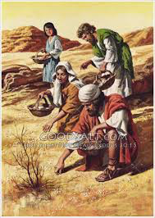
(3)
1. What are our physical needs?—Our bodies are hungry for bread (rice/food), thirsty for water, tired for rest (sleep), gasping for air (medicine/health) and clothed for protection from heat and cold. Our daily physical needs are food, water, rest, air, and clothing.
a. Problem: Wants vs. Needs.
Wants: Israelites craved for meat (Ex.16:3), fish, cucumbers, melons, leeks, onions, garlic (Nu.11:5).
(2) Situations: In the desert there is no
meat, fish, vegetables or spices.
(3) Needs: They called it “manna”
(What is it?).
Where God leads me I will follow,
what He feeds me I will swallow.

Slide 4
b. Response: Grumbling vs. Giving thanks.
(1)Grumblings:Israelites grumbled over every crisis.The people grumbled against Moses. (Ex.15:24) In the desert the whole community grumbled against Moses and Aaron. (16:2) They grumbled against Moses.(17:3) All the Israelites grumbled against Moses and Aaron.(Nu.14:2) Who is Aaron that you should grumble against him? (16:11) The whole Israelite community grumbled against Moses and Aaron. (16:41).
(4)
(2) Source: Grumbling comes from the heart. You are not grumbling against us, but against the Lord.” (Ex.16:8) They neither glorified him as God nor gave thanks to him(Ro.1:21).
(3) Thanksgiving: Jesus gave thanks (Mt.14:19; 15:35). Thanksgiving is a command in the Bible. Give thanks to the Lord.(Ps.107:1) Always giving thanks to God the Father for everything.(Eph.5:20) Give thanks in all circumstances; for this is God’s will for you in Christ Jesus.(1Thes.5:18)

Slide 5
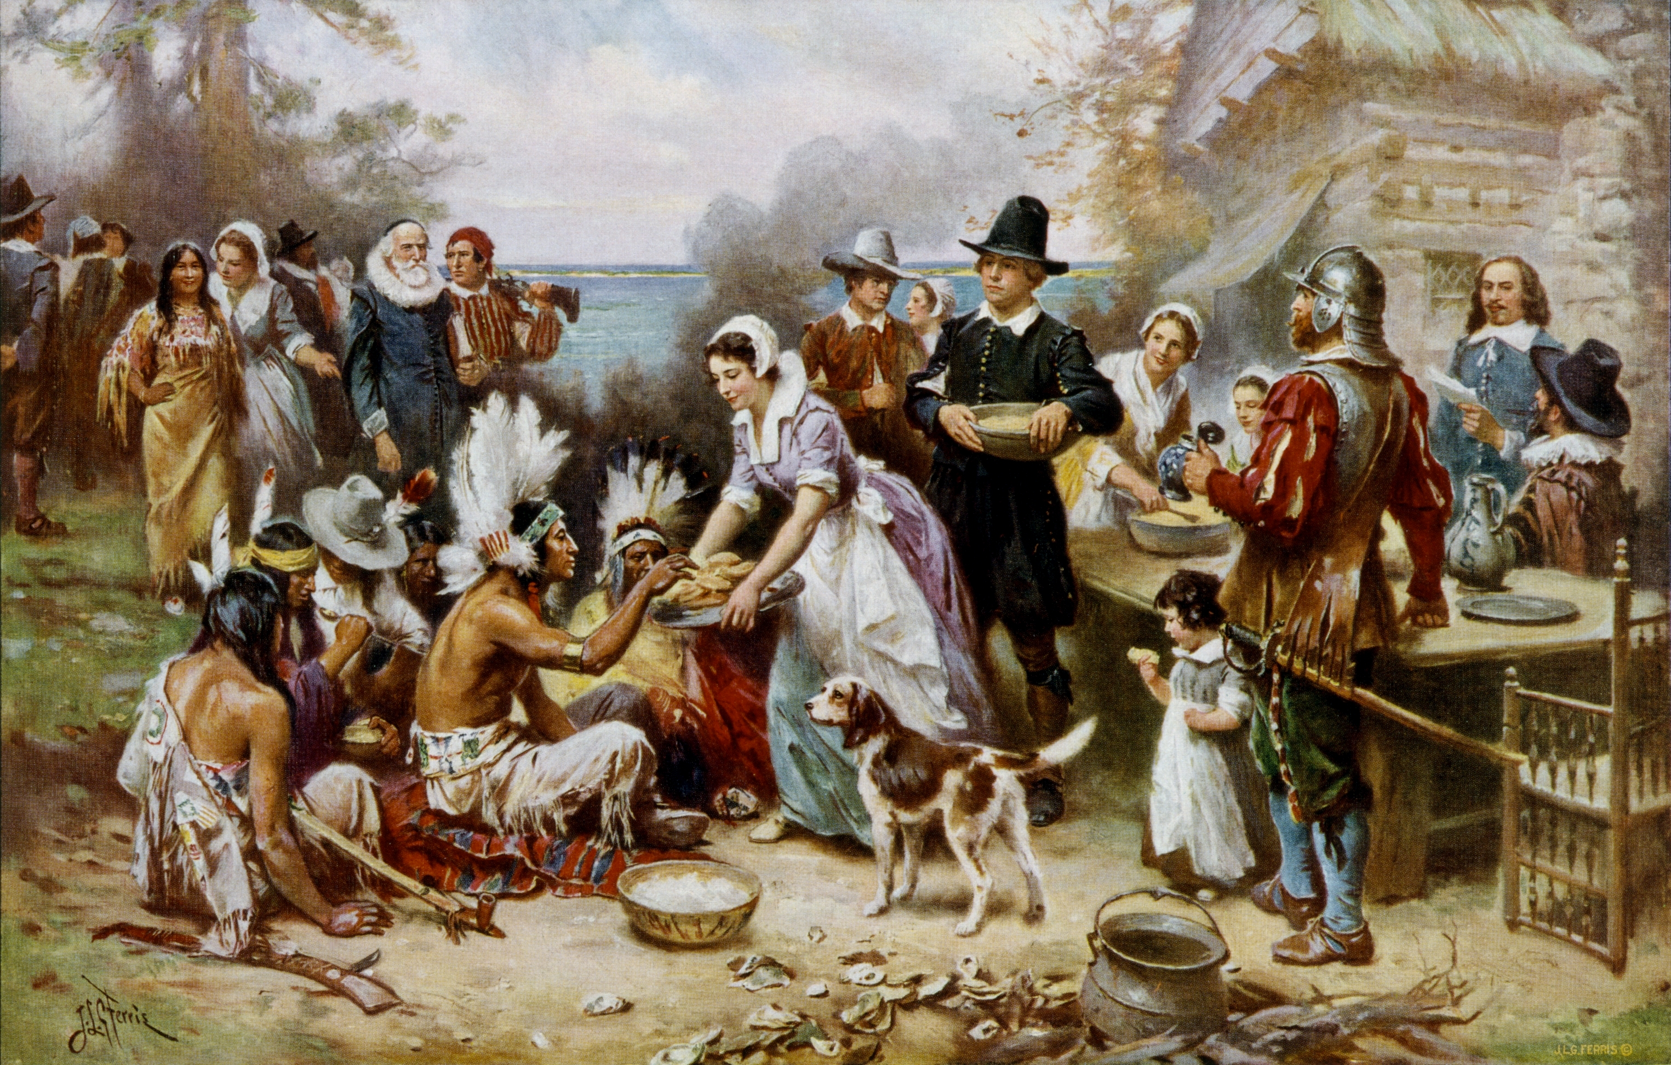
(5)
When what is traditionally known as the first Thanksgiving was celebrated in America in 1621,Native Americans met with the Pilgrims for a three-day festival and feasted on venison, shellfish, and home-grown vegetables. They celebrated the harvest,perseverance through harsh times,and the unity among the two people groups. However, it wasn’t until 1863, under President Abraham Lincoln after a campaign by writer Sara Hale, that Thanksgiving became an annual national tradition.

Slide 6
2. What are our spiritual needs?— Our spirits are hungry for truth and thirsty for life.
a. Jesus is our spiritual bread. “I am the bread of life; who-ever comes to me shall not hunger, and whoever believes in me shall never thirst" (Jn.6:35) Christ shows that he is the true Bread; he is to the soul what bread is to the body, nourishes and supports the spiritual life. He is the Bread of God. Bread which the Father gives, which he has made to be the food of our souls. Bread nourishes only by the powers of a living body; but Christ is himself living Bread, and nourishes by his own power.The doctrine of Christ crucified is now as strength-ening and comforting to a believer as ever it was. He is the Bread which came down from heaven. It denotes the Divinity of Christ's person and his authority; also, the Divine origin of all the good which flows to us through him. Lord, evermore give us this Bread.
(6)

Slide 7
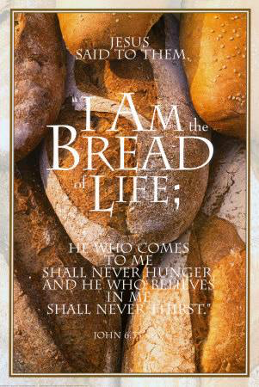
Physical food: This is good! This is delicious!
Can I tell you about something better?
(7)

Slide 8
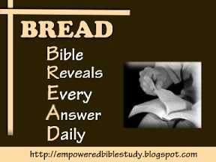
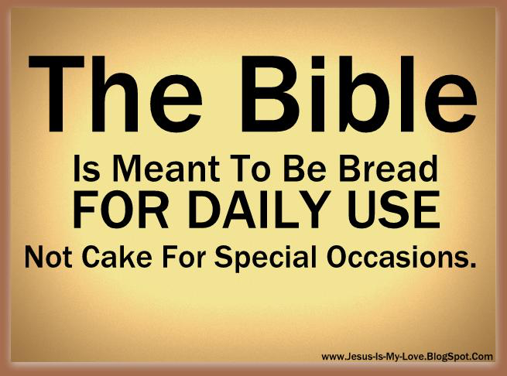
The Bible is also our spiritual bread.
He humbled you, causing you to hunger and then feed-ing you with manna,which neither you nor your ances-tors had known, to teach you that man does not live on bread alone but on every word that comes from the mouth of the Lord.(Deut.8:3) I have not departed from the commands of his lips; I have treasured the words of his mouth more than my daily bread. (Job 23:12)
(8)
Have you had your daily Bread? BREAD =
Bible
Reveals
Every
Answer
Daily

Slide 9
(9)
3.What are our emotional needs?—Our souls are hungry and thirsty for love and acceptance.
Spouses should give love and acceptance to each other. However,each one of you also must love his wife as he loves himself, and the wife must respect her husband. (Eph.5:25-33). Parents should give love and accept-ance to their children. Then they can urge the younger women to love their husbands and children. (Titus 2:4)
4.What are our social needs?Our hearts are hungry & thirsty for friendship & fellowship(He.10:24-25).
5.What are our work needs? Our minds are hungry and thirsty for doing a good job(1Co.10:31).
6.What are our financial needs?Our wallets are hun-gry and thirsty for money to pay bills.(Mt.17:24-26)

Slide 10
Conclusion:
(10)
And my God will meet all your needs according to the riches of his glory in Christ Jesus.(Phil.4:19) “Great is Thy Faithfulness.” Chorus: “Great is Thy Faithfulness!
Great is Thy Faithfulness! Morning by morning new mercies I see; All I have needed Thy hand hath provided. Great is Thy faithfulness, Lord, unto me!”
How do we apply? “Give us this day our daily bread.”
(1) Pray for your needs not for your wants.
(2) Respond with thanksgiving and not with grumbling. (3) Depend upon God and not upon self.
(4) Invite others to Thanksgiving(Appreciation)Dinner.
(5) Show thanks (Thank You or Appreciation card— Thanksgiving: Because of you…heart is grateful…).

Slide 11
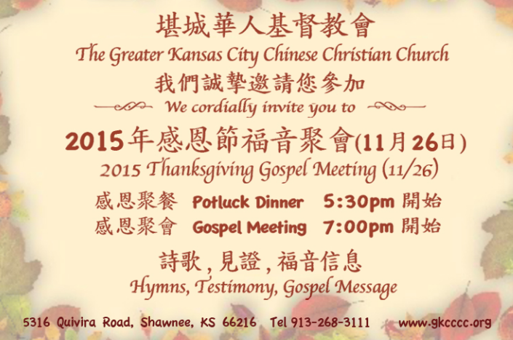
(11)

Slide 12



Slide 13

感恩
Thanksgiving
Because
of you…
heart is
grateful…

Slide 14
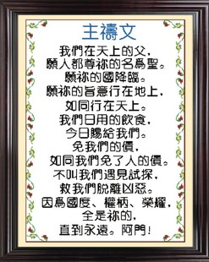
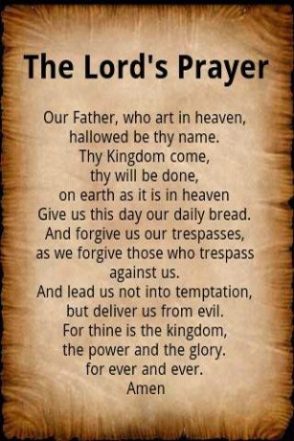
(12)

