Slide 1
Pastor Gary Hart December 13, 2015 Lord’s Prayer-6
(1)
Text: “Therefore, the kingdom of heaven is like a king who wanted to settle accounts with his servants. As he began the settlement, a man who owed him ten thousand bags of gold [20 years wages] was brought to him. Since he was not able to pay, the master ordered that he and his wife and his children and all that he had be sold to repay the debt. “At this the servant fell on his knees before him. ‘Be patient with me,’ he begged, ‘and I will pay back everything.’ The servant’s master took pity on him, canceled the debt and let him go. “But when that servant went out, he found one of his fellow servants who owed him a hundred silver coins [1 day’s wage]. He grabbed him and began to choke him. ‘Pay back what you owe me!’ he demanded. “His fellow servant fell to his knees and begged him, ‘Be patient with me, and I will pay it back.’ “But he refused. Instead, he went off and had the man thrown into prison until he could pay the debt. When the other servants saw what had happened, they were outraged and went and told their master everything that had happened. “Then the master called the servant in. ‘You wicked servant,’ he said,‘I canceled all that debt of yours because you begged me to. Shouldn’t you have had mercy on your fellow servant just as I had on you?’ In anger his master handed him over to the jailers to be tortured, until he should pay back all he owed. “This is how my heavenly Father will treat each of you unless you forgive your brother or sister from your heart.”(Mt.18:23-35)

Slide 2
Title: “Four gifts to ask for, to accept, to give, and to receive.”
Intro: Jesus is teaching disciples’ prayer. What is prayer?
a. Prayer is calling on God’s name (Our Father, who art in heaven).
b. Prayer is seeing God’s greatness (Hallowed be thy name).
c. Prayer is seeking God’s mission (Thy kingdom come).
d. Prayer is looking for God’s plan (Thy will be done).
e. Prayer is declaring dependence on God (Give us this day our daily bread).
f. Prayer is communicating with God (And forgive us our
trespasses, as we forgive those who trespass against us).
(2)

Slide 3
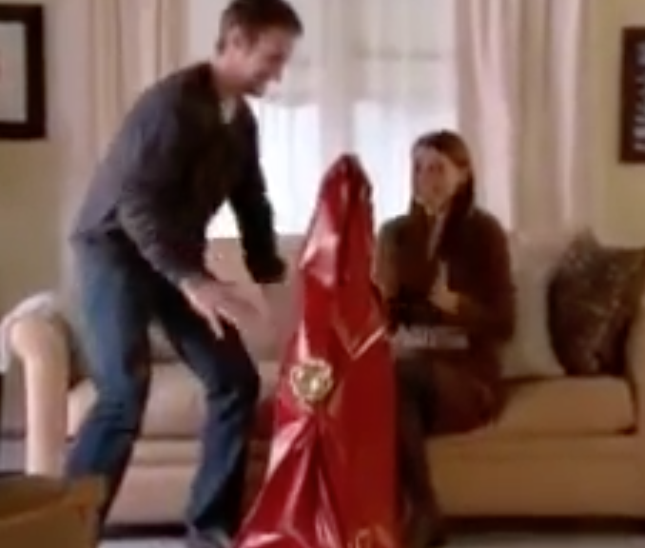
(1) What breaks communication? To trespass with attitudes, words, or actions that cross the line.
(2) What restores communication? To forgive.
https://www.youtube.com/watch?v=Twivg7GkYts
What are good gifts?
What are bad gifts?
(3)

Slide 4
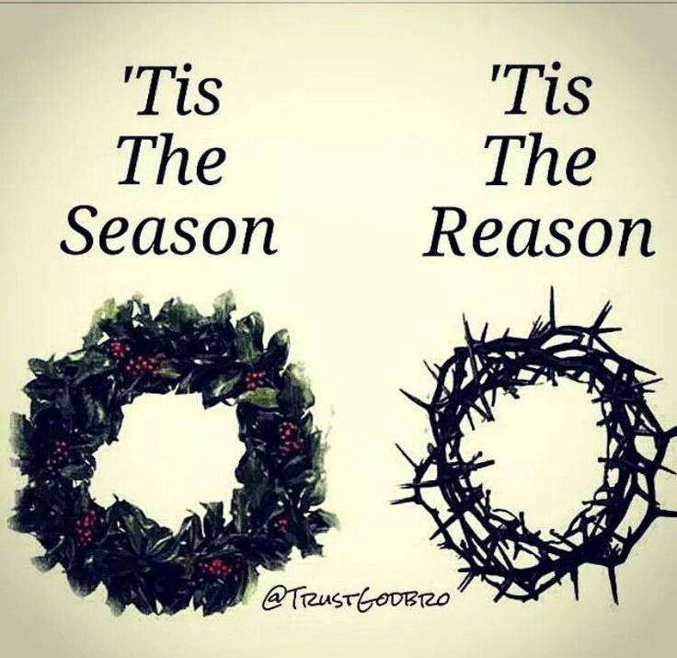
for giving.
forgiving.
(4)

Slide 5
1. Gift #1: Asking God’s Forgiveness of us.
a. Why does God forgive? Because of…
(1) His compassion. “The Lord, the compassionate and gracious God, slow to anger, abounding in love and faithfulness, maintaining love to thousands, and forgiving wickedness, rebellion and sin…” (Ex.34:6-7).
(2) His love. Have mercy on me, O God, according to your unfailing love; according to your great compassion blot out my transgressions (Ps.51:1).
(3) His grace. The Lord is compassionate and gracious, slow to anger, abounding in love (Ps.103:8).
(4) His mercy. Let the wicked forsake their ways and the unrighteous their thoughts. Let them turn to the Lord, and he will have mercy on them, and to our God, for he will freely pardon (Isa.55:7).
(5)

Slide 6
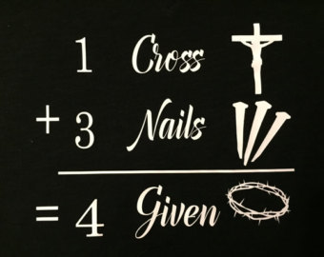
1. Gift #1: Asking God’s Forgiveness of us.
b. How does God forgive?
(1) For salvation: In fact, the law requires that nearly everything be cleansed with blood, and without the shedding of blood there is no forgiveness.(Heb.9:22).God made you alive with Christ. He forgave us all our sins…he has taken it away, nailing it to the cross.(Col.2:13-14).
(2) For fellowship: “Those who have had a bath need only to wash their feet; their whole body is clean” (Jn.13:10). Cleanse me with hyssop, and I will be clean; wash me, and I will be whiter than snow. (Ps.51:7). Restore to me the joy of your salvation (Ps.51:12).
(6)

Slide 7
1. Gift #1: Asking God’s Forgiveness of us.
c. What happens to our sins?
(1) They go out of sight. You have put all my sins behind your back. (Isa.38:17).
(2) They go out of reach. They go out of reach as far as the east is from the west, so far has he removed our transgressions from us. (Ps.103:12).
(3) They go out of mind. “I, even I, am he who blots out your transgressions, for my own sake, and remembers your sins no more.” (Isa.43:25) “For I will forgive their wickedness and will remember their sins no more.” (Jer.31:34).
(4) They go out of existence. Hide your face from my sins and blot out all my iniquity. (Ps.51:9).
(7)

Slide 8
2. Gift #2: Accepting God’s Forgiveness of us.
a. Why ask God for forgiveness? Because we have sinned against God. Against you, you only, have I sinned and done what is evil in your sight; so you are right in your verdict and justified when you judge. (Ps.51:4).
b. How to ask for God’s forgiveness.
(1)We must confess our sins.If we confess our sins,he is faithful and just and will forgive us our sins and purify us from all unrighteousness(1Jn.1:9).
(2) We must repent of our sins. Repent, then, and turn to God, so that your sins may be wiped out…(Ac.3:19).
(3) We must believe in Christ. All the prophets testify about him that everyone who believes in him receives forgiveness of sins through his name.” (Acts 10:43).
c. What happens to our guilt?Then I acknowledged my sin to you and did not cover up my iniquity. I said, “I will confess my transgressions to the Lord.” And you forgave the guilt of my sin. (Ps.32:5) He forgives and takes away guilt.
(8)

Slide 9
3. Gift #3: Giving Forgiveness to others.
a. Why should we forgive others? Because…
(1) God forgives. For if you forgive other people when they sin against you, your heavenly Father will also forgive you. But if you do not forgive others their sins, your Father will not forgive your sins. (Mt. 6:14,15)
(2) Jesus forgave. Jesus said, “Father, forgive them, for they do not know what they are doing.” (Lk.23:34).
(3) Christians forgive. “Lord,do not hold this sin against them.”(Acts 7:60). Be kind and compassionate to one another, forgiving each other, just as in Christ God forgave you. (Eph.4:32)
b. How often should we forgive? Then Peter came to Jesus and asked, “Lord, how many times shall I forgive my brother or sister who sins against me? Up to seven times?” Jesus answered, “I tell you, not seven times, but seventy-seven times. (Mt.18:21-22) “If your brother or sister sins against you, rebuke them;and if they repent, forgive them.Even if they sin against you seven times in a day and seven times come back to you saying ‘I repent,’ you must forgive them.” (Lk.17:3-4)
(9)

Slide 10
3. Gift #3: Giving Forgiveness to others.
c. What happens to our heart? Instead of becoming bitter, we become better. Because you are to clothe yourselves with compassion, kindness, humility, gentleness and patience. Bear with each other and forgive one another if any of you has a grievance against someone. Forgive as the Lord forgave you. And over all these virtues put on love, which binds them all together in perfect unity. (Col.3:13)
Pastor Davy Blackburn’s statement after his pregnant wife had been shot in the head during a home invasion. “My hope is for 3 things in the weeks and months to come: (1) That the court system would have wisdom on how to prosecute this man, so that no one else endures the pain Amanda and our family have had to endure because of his actions. (2) That through all of this and although there will be great consequences for his actions, he would become truly sorry for what he has done and would even begin to experience the life-transforming power of the Grace and Mercy of Jesus Christ. (3)That Jesus would give me and our family a heart of forgiveness. Though everything inside of me wants to hate, be angry, and slip into despair I choose the route of forgiveness, grace and hope... Today I am deciding to love, not hate. Today I am deciding to extend forgiveness, not bitterness. Today I am deciding to hope, not despair. By Jesus’ power at work within us, the best is STILL yet to come. Even when I don’t see it, I believe it to be true.”
http://www.foreverymom.com/this-pastors-message-for-the-man-who-killed-his-pregnant-wife-should-bring-us-all-to-our-knees/
(10)

Slide 11
4. Gift #4: Receiving Forgiveness from others.
a.Why should I ask forgiveness? Therefore confess your sins to each other and pray for each other so that you may be healed. (James 5:16).
b. How should we ask for forgiveness? To apologize (“I am sorry”), to confess all wrong-doing (“I was wrong”), to seek forgiveness (“Please forgive me”) followed by changed attitudes, words, and actions, and to restore in relationship (“Peace and harmony”).
c.What happens to our relationships? “If your brother or sister sins, go and point out their fault, just between the two of you. If they listen to you, you have won them over.” (Mat.18:15)
(11)

Slide 12

Conclusion: It is time to get out of the doghouse:with God and with others.How can you get out of the doghouse? How do you apply?
(1) I will ask for God’s forgiveness to establish my relationship and to maintain fellowship with God.
(2) I will accept God’s forgiveness.
(3) I will forgive others who have wronged me.
(4) I will ask forgiveness from others.
Let us say the Lord’s Prayer together,
“Our Father, who art in heaven…”
Pastor Sam Shockley will come to sing
for us the Lord’s Prayer.
(12)

Slide 13
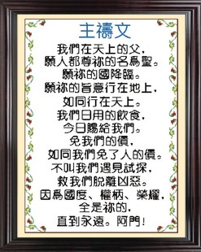
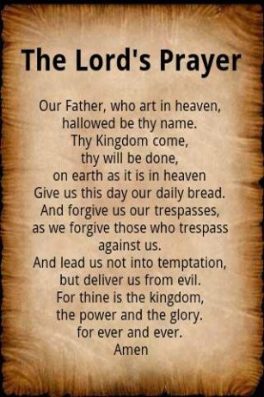
(12)

