Slide 1
Pastor Gary Hart Dec.20, 2015 Lord’s Prayer-7+8
Text: Jesus went out as usual to the Mount of Olives, and his disciples followed him. On reaching the place, he said to them, “Pray that you will not fall into temptation.” He withdrew about a stone’s throw beyond them, knelt down and prayed, “Father, if you are willing, take this cup from me; yet not my will, but yours be done.” An angel from heaven appeared to him and strengthened him. And being in anguish, he prayed more earnestly, and his sweat was like drops of blood falling to the ground. When he rose from prayer and went back to the disciples, he found them asleep, exhausted from sorrow. “Why are you sleeping?” he asked them. “Get up and pray so that you will not fall into temptation.” (Lk.22:39- 46)
Title: “What are you asking for Christmas or New Year.”
(1)

Slide 2
Intro: Jesus is teaching disciples’ prayer. What is prayer?
a. Prayer is calling on God’s name (Our Father, who art in heaven).
b. Prayer is seeing God’s greatness (Hallowed be thy name).
c. Prayer is seeking God’s mission (Thy kingdom come).
d. Prayer is looking for God’s plan (Thy will be done).
e. Prayer is declaring dependence on God (Give us this day our daily bread).
f. Prayer is communicating with God (And forgive us our
trespasses, as we forgive those who trespass against us).
g. Prayer is asking for God’s help to be victorious (And lead us not into temptation, but deliver us from evil).
(2)

Slide 3

1. What is temptation?
a. It is not a sin to be tempted. Jesus was tempted. For we do not have a high priest who is
unable to empathize with
our weaknesses, but we
have one who has been
tempted in every way,
Just as we are—yet he did
not sin. (Heb.4:15)
b. It is an invitation to do evil or something wrong.
Choose wrong and you fall into sin.
c. It is an opportunity to do good or something right. Choose right and you grow in character.
(3)

Slide 4
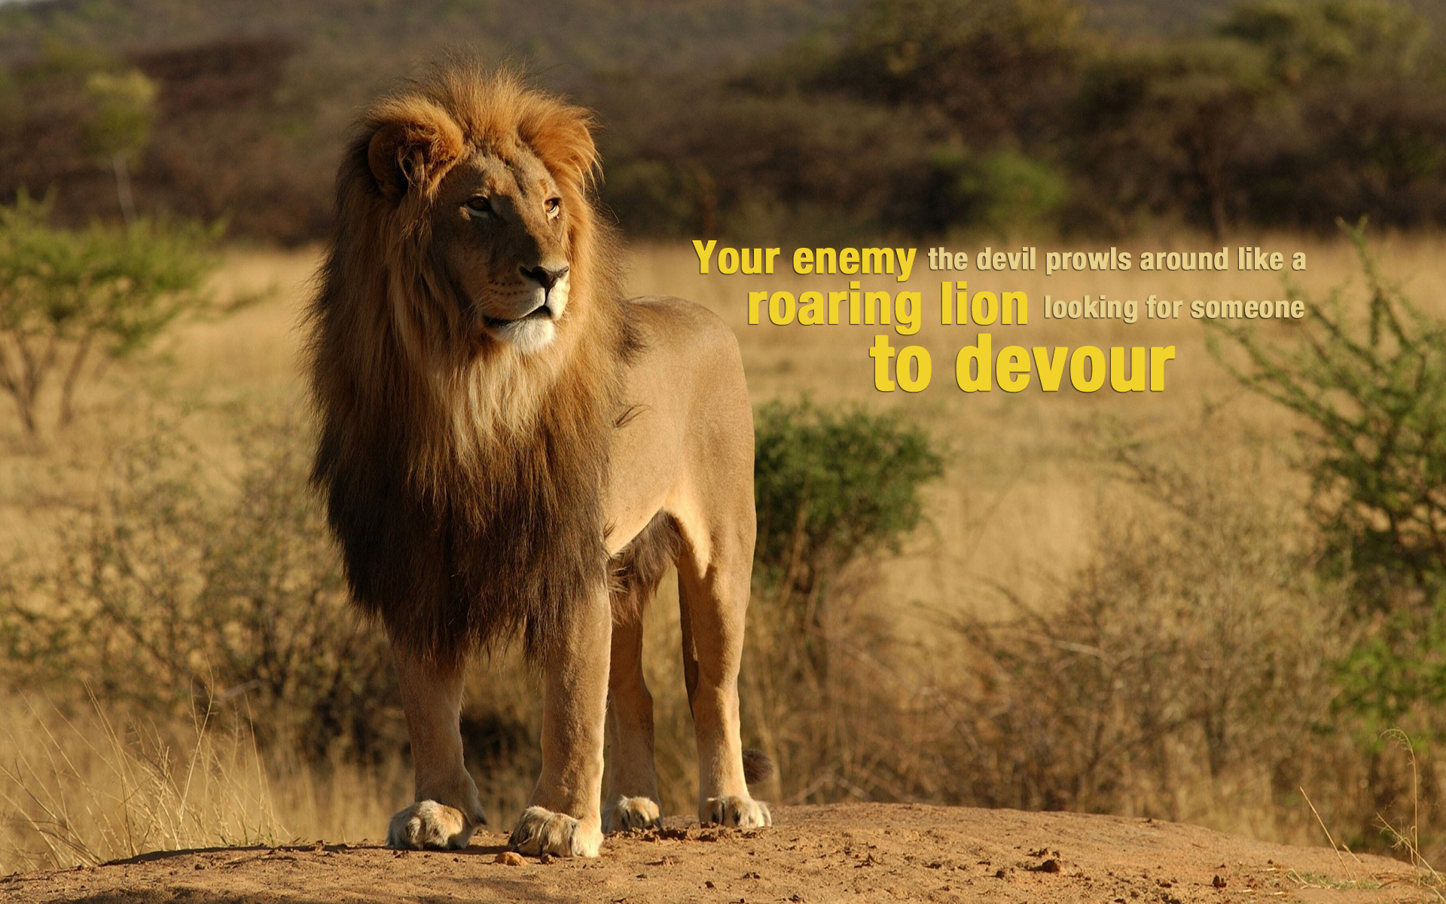
2. What are the sources of Temptation?
(4)
It is not God. When tempted, no one should say, “God is tempting me.” For God cannot be tempted by evil, nor does he tempt anyone. (James 1:13) You have three enemies.
a. The Devil (Satan). Be alert and of sober mind. Your enemy the devil prowls around like a roaring lion looking for some-one to devour.
(1Pet.5:8) I was
afraid that in
some way the
tempter had
tempted you.
(1 Th.3:5)

Slide 5
2. What are the sources of Temptation?
b. The World (System). For everything in the world—the lust of the flesh, the lust of the eyes, and the pride of life—comes not from the Father but from the world. (I Jn.2:16) Those who want to get rich fall into temptation and a trap and into many foolish and harmful desires that plunge people into ruin and destruction. For the love of money is a root of all kinds of evil. Some people, eager for money, have wandered from the faith and pierced themselves with many griefs. (1Ti.6:9-10)
c. The Flesh. For it is from within, out of a person’s heart, that evil thoughts come—sexual immorality, theft, murder, adultery, greed, malice, deceit, lewdness, envy, slander, arrogance and folly. All these evils come from inside and defile a person.” (Mk.7:21-23) For if you live according to the flesh, you will die; but if by the Spirit you put to death the misdeeds of the body, you will live. (Rom.8:13)
(5)

Slide 6
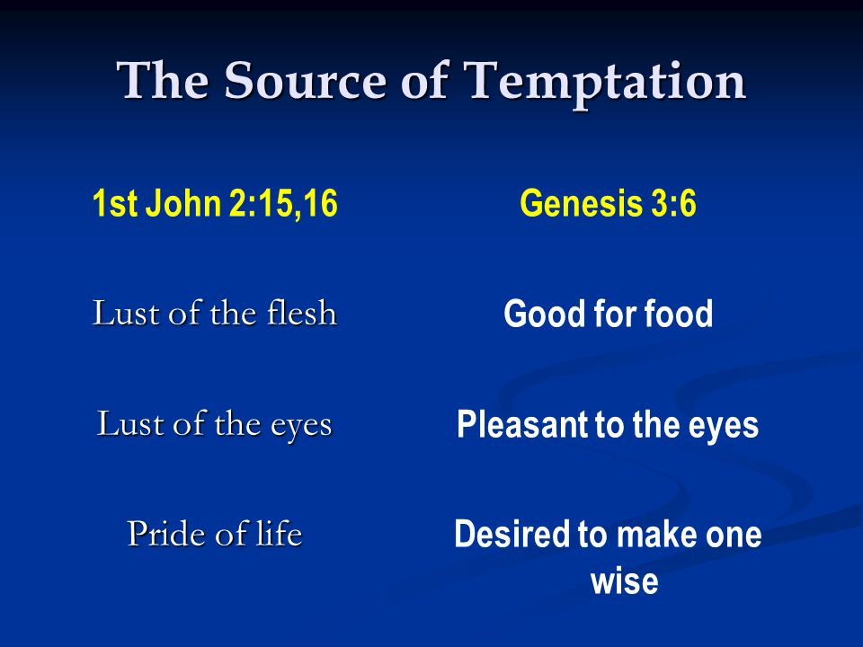
(6)

Slide 7
3. How does temptation work?
a. Desires. What causes fights and quarrels among you? Don’t they come from your desires that battle within you?(James 4:1)
b. Doubt. See to it, brothers and sisters, that none of you has a sinful, unbelieving heart that turns away from the living God.(Hebrew 3:12)
c. Deception. You belong to your father, the devil, and you want to carry out your father’s desires.He was a murderer from the beginning, not holding to the truth, for there is no truth in him. When he lies, he speaks his native language, for he is a liar and the father of lies. (Jn.8:44)
d. Disobedience. But each person is tempted when they are dragged away by their own evil desire and enticed. Then, after desire has conceived, it gives birth to sin; and sin, when it is full-grown, gives birth to death. (James 1:14-15)
(7)

Slide 8

4. How to overcome temptation?
(8)
a. Watch and pray. “Watch and pray so that you will not fall into temptation. The spirit is willing, but the flesh is weak.”
(Mt.26:41) Recognize your pattern of temptation and be prepared for it. Where are you most vulnerable to temptation? Where are your weaknesses? (It could be time,location,people, feelings of exhaustion, loneliness, stress, self-pity, anger, hurt, and even success). In order that Satan might not outwit us. For we are not unaware of his schemes (2 Cor.2:11)
Christmas Time: There were many like Simeon (Lk.2:25-35) and Anna (2:36-38) who watched and prayed for the first coming of the Messiah. We must also watch and pray for the second coming of Christ.

Slide 9

4. How to overcome temptation?
b. Stand and fight. Refuse to be intimidated. Submit yourselves, then, to God. Resist the devil, and he will flee from you. (James 4:7) Put on the full armor of God, so that you can take your stand against the devil’s schemes… Take the helmet of salvation and the sword of the Spirit, which is the word of God. (Eph.6:11,17)
Christmas Time: The birth of Jesus was announced to the World. God sent the light into the world to destroy darkness. God confronts evil.We are to be the light and salt of the world until Christ’s second coming.
(9)

Slide 10

4. How to overcome temptation?
c. Look for the exit and run. So, if you think you are standing firm, be careful that you don’t fall! No temptation has over-taken you except what is common to mankind. And God is faithful; he will not let you be tempted beyond what you can bear. But when you are tempted, he will also provide a way out so that you can endure it. (1 Cor.10:12,13) Flee the evil desires of youth and pursue righteousness, faith, love and peace, along with those who call on the Lord out of a pure heart. (2 Tim.2:22) (Joseph with Potiphar’s wife)
Christmas Time: After the wise men, King Herod sought to kill the baby Jesus, but God told Joseph about the way out, to escape to Egypt. (Mt.2:13-18) Before Jesus second coming,
we are to look for the exit,
the rapture of the believers.
(10)

Slide 11
Conclusion: “Call on me in the day of trouble; I will deliver you, and you will honor me.” (Psalm 50:15) “Simon, Simon, Satan has asked to sift all of you as wheat. But I have prayed for you, Simon, that your faith may not fail. And when you have turned back, strengthen your brothers.” (Lk.22:31-32) How to apply: (1)Expect temptation to come knocking at your door. It may knock gently or it may try to break down your door. Watch and pray! (2) Do not invite temptation to enter, but resist with all your protection and weapons. Stand and fight! Ask Jesus to help you and to answer the door. (3) Do not answer the door. Look for the exit and run from the fire. Let us then approach God’s throne of grace with confidence, so that we may receive mercy and find grace to help us in our time of need. (Heb.4:16) Let us say the Lord’s Prayer together, “Our Father…”
(11)

Slide 12
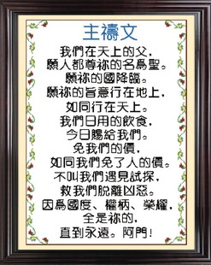

(12)

