Slide 1
信息题目 (Message Topic)
我應當以我父的事為念
I must be about my Father's business
路加福音Luke 2:41-49
讲员:王弟兄 Speaker: Brother Wang
05/26/24
惟耶和华在他的圣殿中。全地的人，都当在他面前肃敬静默。
The Lord is in his holy temple; let all the earth be silent before him.
哈巴谷书 Habakkuk 2:20

Slide 2
宣召 Calling to Worship
馬太福音 11:28-30
28: 凡勞苦擔重擔的人可以到我這裏來，我就使你們得安息。
29: 我心裏柔和謙卑，你們當負我的軛，學我的樣式；這樣，
你們心裏就必得享安息。
30: 因為我的軛是容易的，我的擔子是輕省的。
28: Come to me, all you who are weary and burdened, and I will
give you rest.
29: Take my yoke upon you and learn from me, for I am gentle
and humble in heart, and you will find rest for your souls.
30: For my yoke is easy and my burden is light.

Slide 4
wǒ di shén wǒ di fù wǒ di pán shí wǒ jìng bài nǐ
我的神 我的父 我的磐石 我敬拜祢
My God, my Lord, my Father, I worship You
nǐ di cí ài fēng shèng di cí ài
祢的慈愛 豐盛的慈愛
Your kindness such loving kindness
yǒng yuǎn yì lì bú biàn jiàn lì dào wàn dài
永遠屹立不變 建立到萬代
Never ceasing, never changing, always true
1/16

Slide 5
wǒ di shén wǒ di fù wǒ di zhěng jiù wǒ zàn měi nǐ
我的神 我的父 我的拯救 我讚美祢
My God, my Lord, my salvation, I worship You
nǐ di xìn shí héng jiǔ di xìn shí
祢的信實 恆久的信實
You are faithful, ever so faithful
yǒng yǒng yuǎn yuǎn jiān lì tiān shàng
永永遠遠堅立天上
From the earth unto the heavens
2/16

Slide 6
wǒ yào huān hū xiàng nǐ jǔ shuāng shǒu
我要歡呼 向祢舉雙手
I will praise You, lift up my hands to You
xiàng nǐ yáng shēng gāo chàng hā lì lù yà
向祢揚聲高唱 哈利路亞
I will sing a new song. Alleluia!
3/16

Slide 7
yīn nǐ xǐ yuè wǒ men shì wǒ di lì liàng róng yào
因祢喜悅我們 是我的力量榮耀
You’re my strength and my joy, in You I find my glory
yuàn zài guāng míng zhōng yǔ nǐ tóng xíng
願在光明中與祢同行
In Your light and love I’ll walk with You
4/16

Slide 8
wǒ yào huān hū xiàng nǐ jǔ shuāng shǒu
我要歡呼 向祢舉雙手
I will praise You, lift up my hands to You
xiàng nǐ yáng shēng gāo chàng hā lì lù yà
向祢揚聲高唱 哈利路亞
I will sing a new song. Alleluia!
5/16

Slide 9
nǐ shì wǒ di zhǔ zǎi shuí néng yǔ wǒ di shén xiàng bǐ
祢是我的主宰 誰能與我的神相比
My God and my Lord, who can ever compare with You?
wǒ yī shēng xiàng nǐ fǔ fú jìng bài
我一生向祢俯伏敬拜
I bow down and humbly worship You
6/16

Slide 10
wǒ di shén wǒ di fù wǒ di pán shí wǒ jìng bài nǐ
我的神 我的父 我的磐石 我敬拜祢
My God, my Lord, my Father, I worship You
nǐ di cí ài fēng shèng di cí ài
祢的慈愛 豐盛的慈愛
Your kindness such loving kindness
yǒng yuǎn yì lì bú biàn jiàn lì dào wàn dài
永遠屹立不變 建立到萬代
Never ceasing, never changing, always true
7/16

Slide 11
wǒ di shén wǒ di fù wǒ di zhěng jiù wǒ zàn měi nǐ
我的神 我的父 我的拯救 我讚美祢
My God, my Lord, my salvation, I worship You
nǐ di xìn shí héng jiǔ di xìn shí
祢的信實 恆久的信實
You are faithful, ever so faithful
yǒng yǒng yuǎn yuǎn jiān lì tiān shàng
永永遠遠堅立天上
From the earth unto the heavens
8/16

Slide 12
wǒ yào huān hū xiàng nǐ jǔ shuāng shǒu
我要歡呼 向祢舉雙手
I will praise You, lift up my hands to You
xiàng nǐ yáng shēng gāo chàng hā lì lù yà
向祢揚聲高唱 哈利路亞
I will sing a new song. Alleluia!
9/16

Slide 13
yīn nǐ xǐ yuè wǒ men shì wǒ di lì liàng róng yào
因祢喜悅我們 是我的力量榮耀
You’re my strength and my joy, in You I find my glory
yuàn zài guāng míng zhōng yǔ nǐ tóng xíng
願在光明中與祢同行
In Your light and love I’ll walk with You
10/16

Slide 14
wǒ yào huān hū xiàng nǐ jǔ shuāng shǒu
我要歡呼 向祢舉雙手
I will praise You, lift up my hands to You
xiàng nǐ yáng shēng gāo chàng hā lì lù yà
向祢揚聲高唱 哈利路亞
I will sing a new song. Alleluia!
11/16

Slide 15
nǐ shì wǒ di zhǔ zǎi shuí néng yǔ wǒ di shén xiàng bǐ
祢是我的主宰 誰能與我的神相比
My God and my Lord, who can ever compare with You?
wǒ yī shēng xiàng nǐ fǔ fú jìng bài
我一生向祢俯伏敬拜
I bow down and humbly worship You
12/16

Slide 16
wǒ yào huān hū xiàng nǐ jǔ shuāng shǒu
我要歡呼 向祢舉雙手
I will praise You, lift up my hands to You
xiàng nǐ yáng shēng gāo chàng hā lì lù yà
向祢揚聲高唱 哈利路亞
I will sing a new song. Alleluia!
13/16

Slide 17
yīn nǐ xǐ yuè wǒ men shì wǒ di lì liàng róng yào
因祢喜悅我們 是我的力量榮耀
You’re my strength and my joy, in You I find my glory
yuàn zài guāng míng zhōng yǔ nǐ tóng xíng
願在光明中與祢同行
In Your light and love I’ll walk with You
14/16

Slide 18
wǒ yào huān hū xiàng nǐ jǔ shuāng shǒu
我要歡呼 向祢舉雙手
I will praise You, lift up my hands to You
xiàng nǐ yáng shēng gāo chàng hā lì lù yà
向祢揚聲高唱 哈利路亞
I will sing a new song. Alleluia!
15/16

Slide 19
nǐ shì wǒ di zhǔ zǎi shuí néng yǔ wǒ di shén xiàng bǐ
祢是我的主宰 誰能與我的神相比
My God and my Lord, who can ever compare with You?
wǒ yī shēng xiàng nǐ fǔ fú jìng bài
我一生向祢俯伏敬拜
I bow down and humbly worship You
16/16

Slide 21
我們屬於你，都是你的百姓，
We are Your people, Who are called by Your name 我們正呼求你，宣揚你的聖名；
We call upon You To declare Your fame 在這黑暗的世代，你召我們發光；
In this age of darkness, You've called us to be light 當我們尋求你面，主啊，顯你大能！ As we seek Your face Lord, Stir up Your might
1/4

Slide 22
建立你教會，來醫治這地，願你國度降臨。
Build Your church, And heal this land Let Your kingdom come 建立你教會，來醫治這地，願你旨意成全。
Build Your church , And heal this land Let Your will be done
2/4

Slide 23
我們屬於你，都是你的百姓，
We are Your people, Who are called by Your name 我們正呼求你，宣揚你的聖名；
We call upon You To declare Your fame 在這黑暗的世代，你召我們發光；
In this age of darkness, You've called us to be light 當我們尋求你面，主啊，顯你大能！ As we seek Your face Lord, Stir up Your might
3/4

Slide 24
建立你教會，來醫治這地，願你國度降臨。
Build Your church, And heal this land Let Your kingdom come 建立你教會，來醫治這地，願你旨意成全。
Build Your church , And heal this land Let Your will be done
4/4

Slide 25
路加福音 Luke 2:41-52
41: 每年到逾越節，他父母就上耶路撒冷去。
42: 當他十二歲的時候，他們按着節期的規矩上去。
43: 守滿了節期，他們回去，孩童耶穌仍舊在耶路撒冷。他的父母並不知道， 44: 以為他在同行的人中間，走了一天的路程，就在親族和熟識的人中找他， 45: 既找不着，就回耶路撒冷去找他。
46: 過了三天，就遇見他在殿裏，坐在教師中間，一面聽，一面問。
47: 凡聽見他的，都希奇他的聰明和他的應對。
48: 他父母看見就很希奇。他母親對他說：「我兒！為甚麼向我們這樣行呢 v
看哪，你父親和我傷心來找你！」
49: 耶穌說：「為甚麼找我呢？豈不知我應當以我父的事為念嗎 ？」
50: 他所說的這話，他們不明白。
51: 他就同他們下去，回到拿撒勒，並且順從他們。他母親把這一切的事都存在心裏。
52: 耶穌的智慧和身量，並神和人喜愛他的心，都一齊增長。

Slide 26
路加福音 Luke 2:41-52
41: Every year Jesus’ parents went to Jerusalem for the Festival of the
Passover.
42: When he was twelve years old, they went up to the festival, according
to the custom.
43: After the festival was over, while his parents were returning home, the
boy Jesus stayed behind in Jerusalem, but they were unaware of it.
44: Thinking he was in their company, they traveled on for a day. Then they
began looking for him among their relatives and friends.
45: When they did not find him, they went back to Jerusalem to look
for him.
46: After three days they found him in the temple courts, sitting among
the teachers, listening to them and asking them questions.

Slide 27
路加福音 Luke 2:41-52
47: Everyone who heard him was amazed at his understanding
and his answers.
48: When his parents saw him, they were astonished. His mother said
to him, “Son, why have you treated us like this? Your father and I
have been anxiously searching for you.”
49: “Why were you searching for me?” he asked. “Didn’t you know I
had to be in my Father’s house?”
50: But they did not understand what he was saying to them.
51: Then he went down to Nazareth with them and was obedient to them.
But his mother treasured all these things in her heart.
52: And Jesus grew in wisdom and stature, and in favor with God and man

Slide 28
18 神聖之愛，遠超眾愛 LOVE DIVINE, ALL LOVES EXCELLING
神聖之愛，遠超眾愛，
Love Divine, all loves excelling,
天上之樂臨地上；
Joy of heav'n, to earth come down;
竟來住我卑微胸懷，
Fix in us Thy humble dwelling,
作我相信的恩賞。
All Thy faithful mercies crown.

Slide 29
恩主，袮是所有憐憫，
Jesus, Thou art all compassion;
袮是純潔無限愛；
Pure, unbounded love Thou art;
眷顧我們，帶來救恩，
Visit us with Thy salvation,
進入相信的胸懷。
Enter ev'ry trembling heart.

Slide 30
（二）
哦，主，向我吹袮聖靈，
Breathe, O breathe Thy loving Spirit
吹進煩擾的心裏；
Into every troubled breast;
使我有分袮的豐盛，
Let us all in Thee inherit,
享受應許的安息。
Let us find the promised rest.

Slide 31
從我除去罪的愛好，
Take away the love of sinning;
除去一切的捆綁；
Alpha and Omega be;
使我認識生命之道，
End of faith, as its beginning,
使我完全得釋放。
Set our hearts at liberty.

Slide 32
（三）
大能的主，前來拯救，
Come, Almighty, to deliver,
賜我生命何豐盛；
Let us all Thy life receive;
願袮同在直到永久，
Suddenly return, and never,
永遠住在袮殿中。
Nevermore Thy temples leave.

Slide 33
我要時常頌讚袮名，
Thee we would be always blessing,
照袮喜悅事奉袮；
Serve Thee as Thy hosts above,
不住禱告，不住頌稱，
Pray, and praise Thee without ceasing,
誇耀袮愛永無已。
Glory in Thy perfect love.

Slide 34
（四）
求袮完成袮的新造，
Finish, then, Thy new creation;
使我純潔無瑕疵；
Pure and spotless let us be;
袮大救恩我全享到，
Let us see Thy great salvation
得以和袮全相似。
Perfectly restored in Thee;

Slide 35
更新變化，榮上加榮，
Changed from glory into glory
直到滿有袮身量；
Till with Thee we take our place,
直到進入榮耀之中，
Till we cast our crowns before Thee,
永遠將袮愛頌揚。
Lost in wonder, love and praise.

Slide 36
祷告 Prayer
第一时段：现场的弟兄姐妹 (On site)
第二时段：线上的弟兄姐妹 (Online)
回到现场 (On site)

Slide 37
祷告 Prayer
第一时段：现场的弟兄姐妹 (On site)
第二时段：线上的弟兄姐妹 (Online)
回到现场 (On site)

Slide 38
祷告 Prayer
第一时段：现场的弟兄姐妹 (On site)
第二时段：线上的弟兄姐妹 (Online)
回到现场 (On site)

Slide 39
信息 Message

Slide 40
Hi Ne Ni 我在这里
耶和華我的主啊！
求祢使我放下心中 放下心中所愛
耶和華我的主啊！
求祢使我打碎心中 心中偶像
Yahweh! O my LORD my God Come and help me forsake my love
Forsake my love, my all
Yahweh! O my LORD my God Help me break down all my idols, idols in my heart
1/7

Slide 41
直到我在敬拜中獻上自己為祭
無怨 無悔 永不回頭
直到我在祭壇那裡得著命定
無怨 無悔 我在這裡
Till I give myself in worship as a sacrifice With no regrets, No turning back Till I at the altar hear the calling for my life With no regrets, Here I am
2/7

Slide 42
Hi-Ne-Ni Hi-Ne-Ni 燒我 , 差我 , 我在這裡 Hi-Ne-Ni Hi-Ne-Ni 燒我 , 差我 Hi-Ne-Ni
Hi-Ne-Ni , Hi-Ne-Ni Purge me, Send me Yes! Here I am Hi-Ne-Ni , Hi-Ne-Ni Purge me, Send me, Hi-Ne-Ni
3/7

Slide 43
耶和華我的主啊！
求祢使我放下心中 放下心中所愛
耶和華我的主啊！
求祢使我打碎心中 心中偶像
Yahweh! O my LORD my God Come and help me forsake my love
Forsake my love, my all
Yahweh! O my LORD my God Help me break down all my idols, idols in my heart
4/7

Slide 44
直到我在敬拜中獻上自己為祭
無怨 無悔 永不回頭
直到我在祭壇那裡得著命定
無怨 無悔 我在這裡
Till I give myself in worship as a sacrifice With no regrets, No turning back Till I at the altar hear the calling for my life With no regrets, Here I am
5/7

Slide 45
Hi-Ne-Ni Hi-Ne-Ni 燒我 , 差我 , 我在這裡 Hi-Ne-Ni Hi-Ne-Ni 燒我 , 差我 Hi-Ne-Ni
Hi-Ne-Ni , Hi-Ne-Ni Purge me, Send me Yes! Here I am Hi-Ne-Ni , Hi-Ne-Ni Purge me, Send me, Hi-Ne-Ni
6/7

Slide 46
為這世界黑暗的角落 我在這裡
為那不曾被安慰的靈魂
我在這裡 Hi-Ne-Ni
我在這裡 Hi-Ne-Ni
For the darkest corners of the world O LORD! Send me! For the souls hopeless in despair, Here I am! Yes! Here I am, Hi-Ne-Ni Yes! Here I am, Hi-Ne-Ni
7/7

Slide 47
回应祷告 Responsive prayer
第一时段：现场的弟兄姐妹 (On site)
第二时段：线上的弟兄姐妹 (Online)
回到现场 (On site)

Slide 48
回应祷告 Responsive prayer
第一时段：现场的弟兄姐妹 (On site)
第二时段：线上的弟兄姐妹 (Online)
回到现场 (On site)

Slide 49
回应祷告 Responsive prayer
第一时段：现场的弟兄姐妹 (On site)
第二时段：线上的弟兄姐妹 (Online)
回到现场 (On site)

Slide 50
报告Announcement
欢迎新朋友 Welcome
主日晨祷 Sunday Morning Prayer
周一晚盼望小组聚会（HOPE Group, 7:30PM）
周三圣达菲公寓查经 （上午十点）
Santa Fe Tower Bible Study (10:00AM)
周三祷告会（晚 7:30 -9:00 教会）
Prayer Meeting (Wednesday 7:30 -9:00 PM, church)
周五团契/查经 Friday Fellowship/Bible Study
北区 (North)、寻求组 (Seekers)、父母组 (Youth Parents)、青少年(Youth)
网上聚会详见图书馆Zoom 链接 (Online zoom meetings: QR Codes in library)

Slide 51
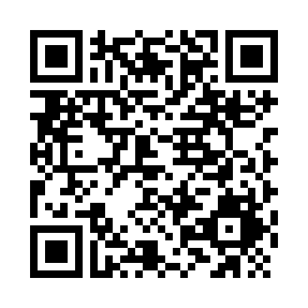
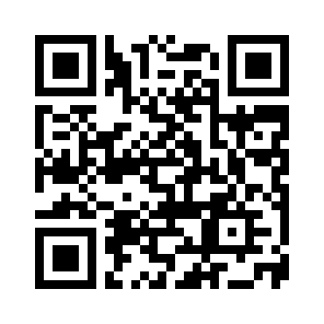
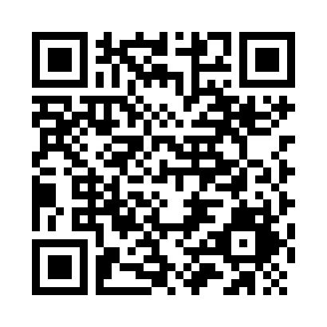
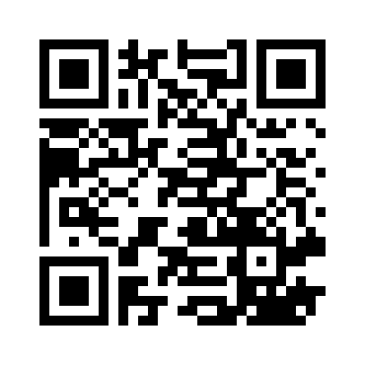
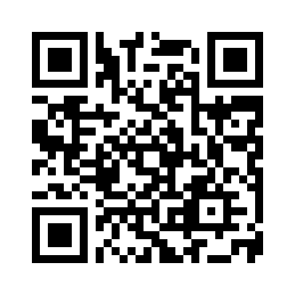
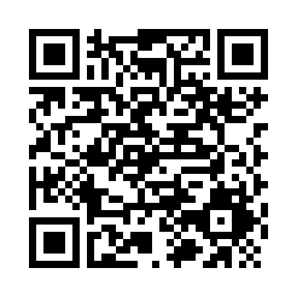
线上聚会链接 QR Codes for Online Meetings
Sunday Service (主日敬拜)
Sunday School (主日学)
Wednesday Prayer (周三祷告会)
North Group (北区团契)
Youth Parents (父母组团契)
Hope Group (盼望小组)

Slide 52
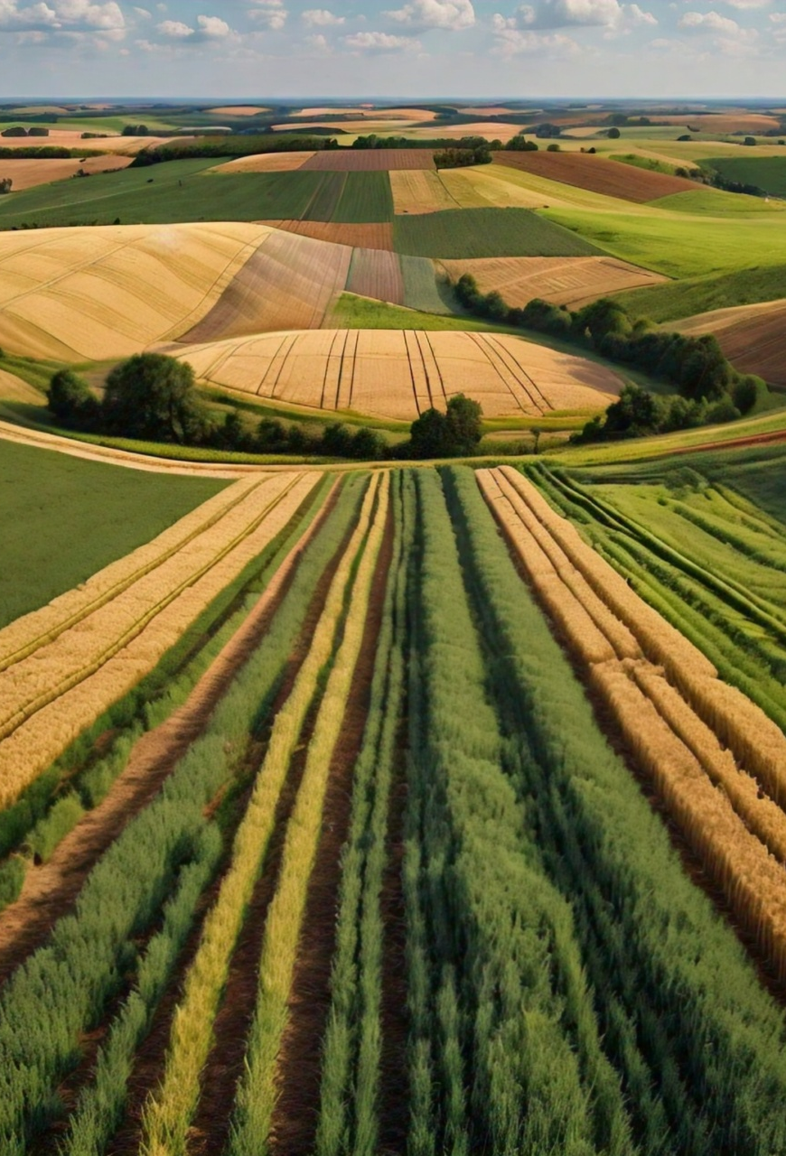
堪城华人基督教会2004夏季特会
讲员：王鸿鸣弟兄
7/26周五晚上:信息1 (7:30-9:00PM)
7/27周六下午: 信息2 (2:30-4:00)、
BBQ (4:00-6:00)、
自由交通 (6:30-8:00)
7/28 主日信息: 信息3

Slide 53
报告Announcement
清洁服事 (Cleaning Service)
本主日 (This Sunday):
项友斌弟兄家
下主日 (Next Sunday):
郑圣民弟兄家

