Slide 1
What Does Jesus Do in You?
Hebrews 13:1-6

Slide 2
Through Jesus Christ, believers are enabled to follow God in two different ways.

Slide 3
First Way: Believers can Love One Another <3
Series of Imperatives: Command Verbs
  Keep… (verse 1)
  Do not Forget… (verse 2)
  Remember… (verse 3)
Echo of Jesus’s Command in John 13:34
  “A new command I give you: Love one another. As I have loved you, so you must love one another”
But How SPECIFICALLY?
  Love one another in Hospitality
  Love one another in Compassion

Slide 4
Love One Another in Hospitality (verse 2)
“Entertain strangers?” (verse 2, NIV 1984)
  Unfortunate translation
“Show hospitality” (verse 2, NIV NASB ESV HCSB NLT…)
3 John 1:5-10
  1st Century Christian Hospitality
Dear friend, you are faithful in what you are doing for the brothers and sisters, even though they are strangers to you. They have told the church about your love. Please send them on their way in a manner that honors God. It was for the sake of the Name that they went out, receiving no help from the pagans. We ought therefore to show hospitality to such people so that we may work together for the truth.

Slide 5
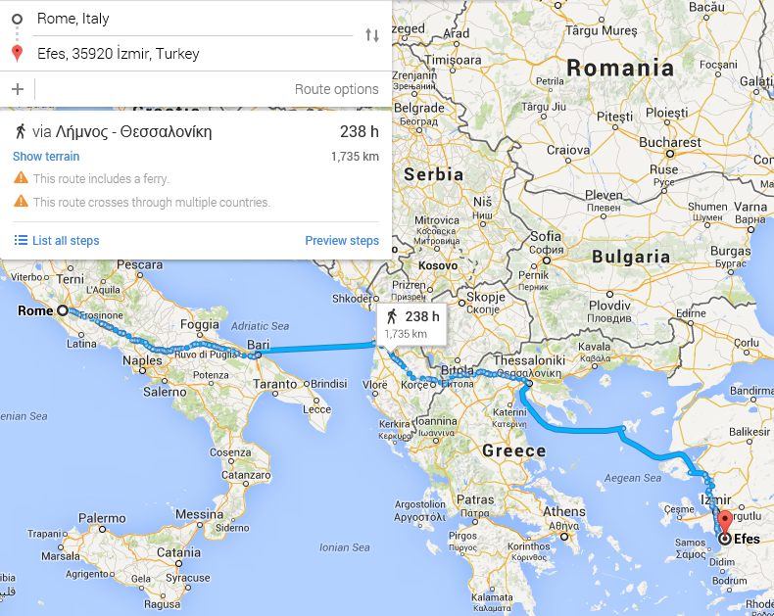
Love One Another in Compassion (verse 3)
“Remember” (verse 3)
  Not just thinking about them!
  But Love in Action
2 Timothy 4:9-13
  Do your best to come to me quickly… When you come, bring the cloak that I left with Carpus at Troas, and my scrolls, especially the parchments.
  Timothy: Senior Pastor in Ephesus
  Month long journey… one way!

Slide 6
Second Way: Believers can Trust God
The main verbs in verse 4 and 5 are _____________________?
  Declarative (Statement)
  Imperative (Command)
  Interrogative (Question)
  THERE ARE NO MAIN VERBS
Signals a topic change… but still understood to be commands
Notice the reasoning given:
  “For God” (verse 4)
  “Because God” (verse 5)

Slide 7
Trust God in Marriage (verse 4)
Obviously don’t Commit Adultery
  But such a low bar!
1 Corinthians 7:2, 5
  Needs to be intimacy with your spouse!
  “Marriage bed kept pure” not just a bunch of Thou Shall Nots!
Song of Songs has a lot of examples!
But since sexual immorality is occurring, each man should have sexual relations with his own wife, and each woman with her own husband… Do not deprive each other except perhaps by mutual consent and for a time, so that you may devote yourselves to prayer. Then come together again so that Satan will not tempt you because of your lack of self-control.

Slide 8
Trust God in Money (5-6)
#1 determinate of who wins the Presidential election?
  “The Economy, STUPID!” - James Carville, Bill Clinton's 1992 campaign strategist
Who here wishes they had more money?
  Why - We think money gives us Power
Deuteronomy 31:6, 8; Joshua 1:5
  Israel was a pitiful, weak nation… and they knew it!
  “Never will I leave you; never will I forsake you.”
Philippians 4:13 - “I can do all things in him who gives me strength.”
Philippians 4:12 - “I know what it is to be in need, and I know what it is to have plenty. I have learned the secret of being content in any and every situation, whether well fed or hungry, whether living in plenty or in want.”

Slide 9
What Does Jesus Do in You?
Through Jesus Christ, believers are enabled to follow God in two different ways.
Believers can Love One Another.
  Love one another in Hospitality.
  Love one another in Compassion.
Believers can Trust God.
  Trust God in Marriage.
  Trust God in Money.

