Slide 1
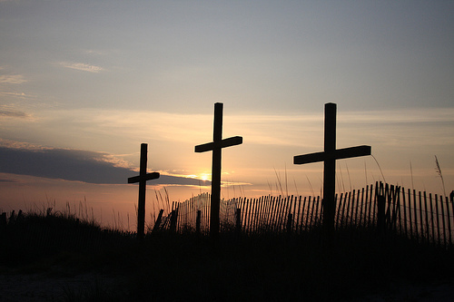
Walking in His Triumph 行在祂的得胜中
John 約翰 12:12-32
GKCCCC 堪城华人基督教会
Apr. 17, 2011

Slide 2
Walking in His Triumph 行在祂的得胜中
⁶ As you therefore have received Christ Jesus the Lord, so walk in Him, ⁷ rooted and built up in Him and established in the faith, as you have been taught, abounding in it with thanksgiving.
(Colossians 2:6-9, NKJV)
⁶你们既然接受了主基督耶稣，就当遵他而行，⁷在他
里面生根建造，信心坚固，正如你们所领的教训，感
谢的心也更增长了。(歌羅西書 2:6-7)

Slide 3
Walking in His Triumph 行在祂的得胜中
Matthew 马太福音 21:1-11

Slide 4
Walking in His Triumph 行在祂的得胜中
His Initiation – Jesus’ triumphal entry (John 12:12-14; Zech. 9:9) 祂所引发 - 耶稣凱旋的进入
Exerting His sovereignty 主宰权柄
Fulfilling the prophecy 应验预言
Riding on a donkey colt 骑着驴驹

Slide 5
Walking in His Triumph 行在祂的得胜中
His Reception – People’s warm welcome (Matt. 21:8-11; Psalm 118:25-26) 祂被接待 - 群众热烈的欢迎
Spreading their garments and palm branches on the road 把衣服和棕树枝铺在路上
Crying Hosanna to the Son of David 喊着说和散那归於大卫的子孙
Recognizing Him as the prophet from Nazareth of Galilee 仍认祂為加利利拿撒勒的先知

Slide 6
Walking in His Triumph 行在祂的得胜中
His Consummation - As a grain of wheat to fall into the ground (John 12:23-32)
祂所成就 - 像一粒麦子落在地里
To produce many grains—to draw all men 结出许多子粒 - 吸引万人
To be glorified and to glorify the Father
得着荣耀並荣耀父
To judge the world and to cast out its ruler, Satan
审判世界並將世界的王撒但赶出去

Slide 7
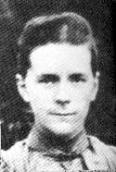
Walking in His Triumph 行在祂的得胜中
Margaret E. Barber 和受恩 (1866–1929), was a British missionary in China. She was born in 1866 in Peasenhall, County Suffolk, England, the daughter of Louis (a wheelwright) and Martha (née Gibbs) Barber. Within her lifetime, she went to China twice to preach the Christian gospel. She left her home and traveled in a lonely way thousands of miles. Barber, who went to China as an Anglican and later became an independent missionary. She had an influence on many others Chinese men and women, amongst others, the most noted of whom was Leland Wang (Wang Cai), who later became a Christian revolutionary leader associated with Watchman Nee and the Church Assembly Hall.
In her Christian ministry, she traveled little and received no publicity, focusing more on a holy living than an outward work. She was known to warn the young Christians against doing a popular work, which she believed would bring shipwreck to their spiritual life. Most of her time was spent in prayer for China and Foochow and also in helping those who sought her spiritual counsel.

Slide 8
Encouragements/Applications from This Text 经文的鼓励与应用
Walking in Jesus’ triumphal, we need to …
行在耶稣的得胜中, 我们需要…
know and receive Him. 认识和接待祂
have His life of humbleness and obedience. 有祂谦卑和顺从的生命
learn how to praise Him and let Him be known by others. 学习赞美祂和让别人认识祂
live a victorious life by walking with Him. 与祂同行过得胜生活
let God to be glorified in your life. 让 神在我们生命中得着荣耀

