Slide 1
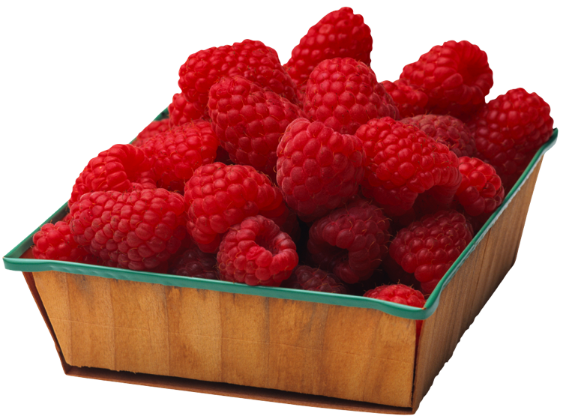
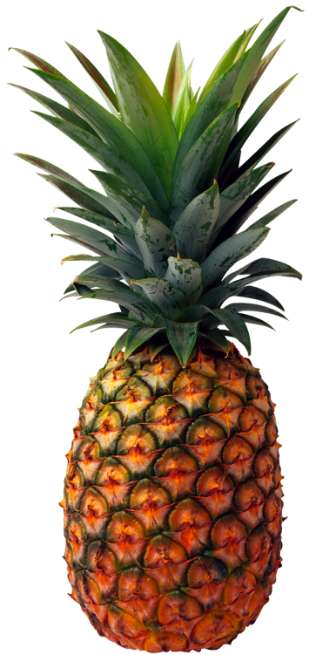
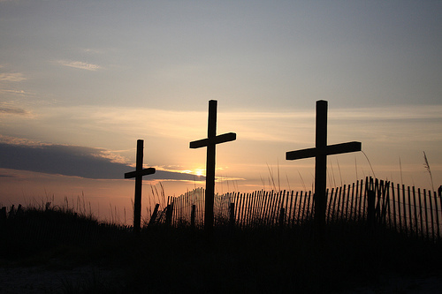
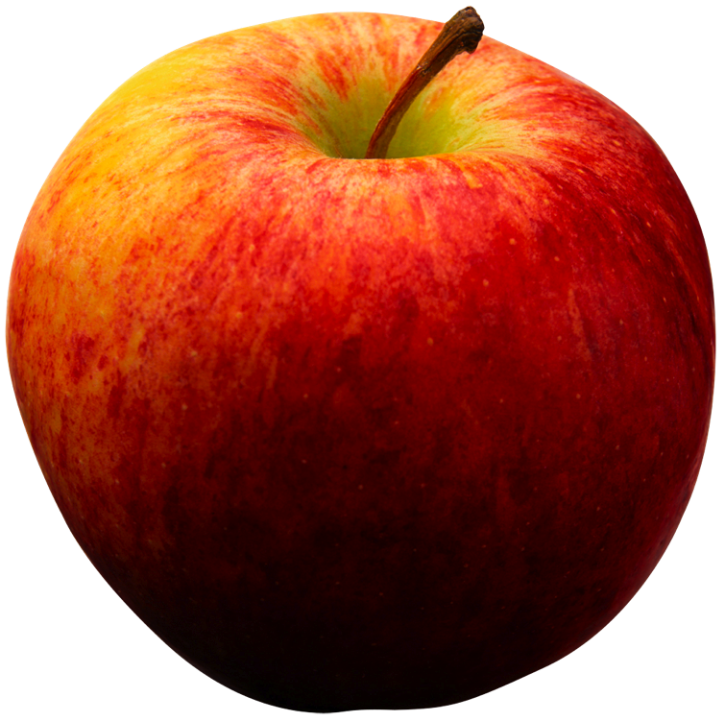
Bearing Fruit As We Walk in Him 我们遵他而行才能结出果实
Acts 使徒行傳 3:1-16; John 約翰 15:1-5; Gal. 加拉太 5:22-23
GKCCCC 堪城华人基督教会
Jul. 24, 2011

Slide 2
Bearing Fruit As We Walk in Him 我们遵他而行才能结出果实
⁶ As you therefore have received Christ Jesus the Lord, so walk in Him, ⁷ rooted and built up in Him and established in the faith, as you have been taught, abounding in it with thanksgiving.
(Colossians 2:6-9, NKJV)
⁶你们既然接受了主基督耶稣，就当遵他而行，⁷在他
里面生根建造，信心坚固，正如你们所领的教训，感
谢的心也更增长了。
(歌羅西書 2:6-7)

Slide 3
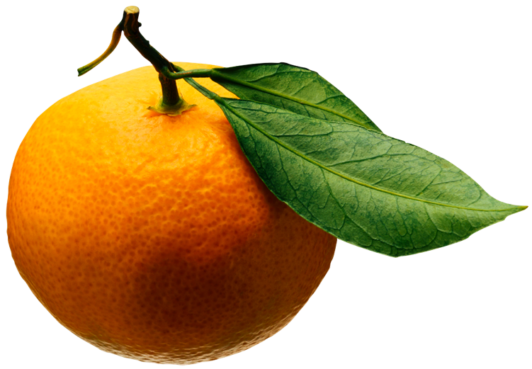
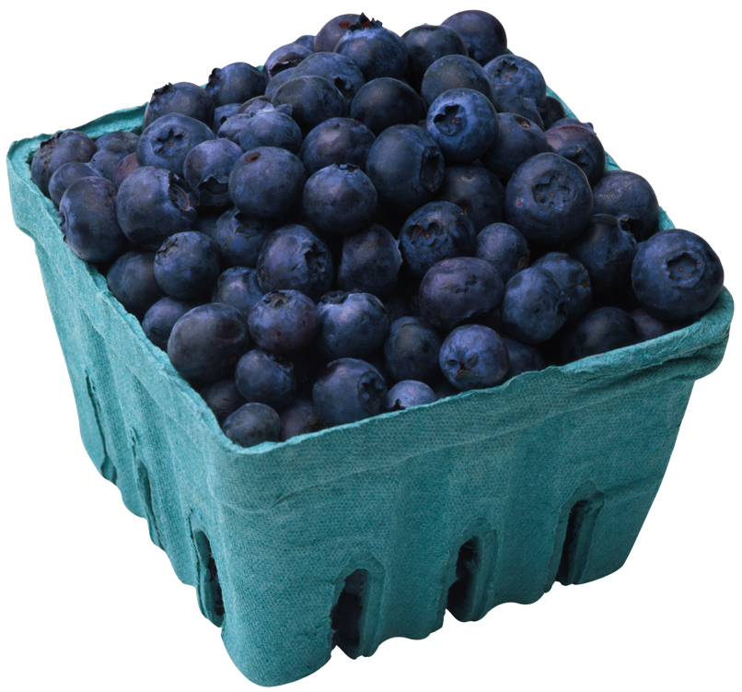
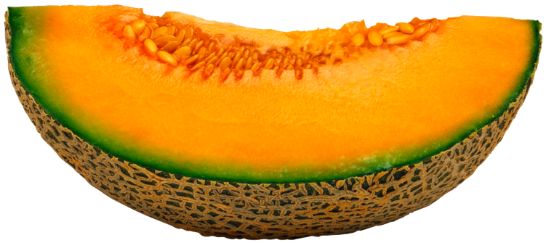
Bearing Fruit As We Walk in Him 我们遵他而行才能结出果实
John 約翰福音 15:1-5; Gal. 加拉太 5:22-23

Slide 4
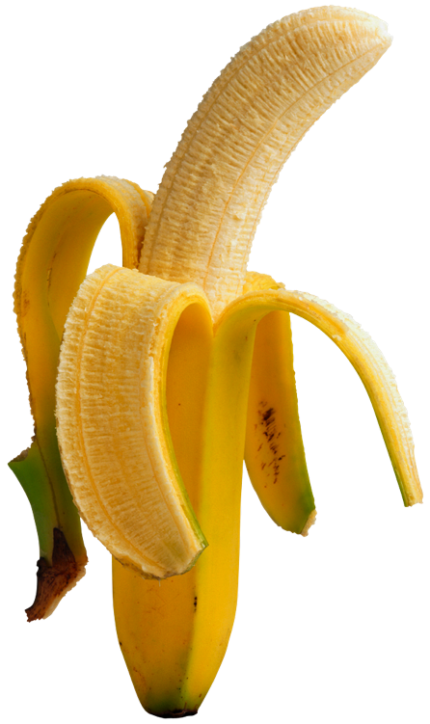
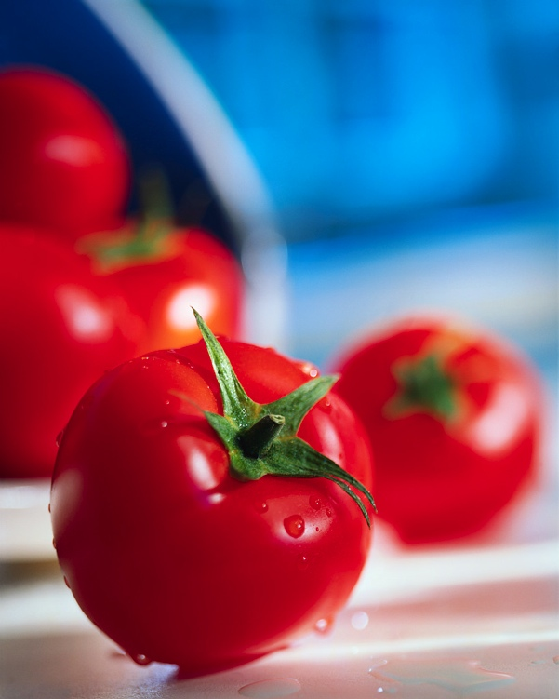
Bearing Fruit As We Walk in Him 我们遵他而行才能结出果实
What is the fruit as we walk in Him? 甚么是我们遵他而行的果子?
^{“22} But the fruit of the Spirit is love, joy, peace, longsuffering, kindness, goodness, faithfulness, ²³ gentleness, self-control…” ²²圣灵所结的果子，就是仁爱、喜乐、和平、忍耐、恩慈、良善、信实、²³温柔、节制。(Gal 5: 22-23a, NKJV)
“He jumped to his feet and began to walk. Then he went with them into the temple courts, walking and jumping, and praising God. “ 就跳起来，站着，又行走，同他们进了殿，走着，跳着，赞美 神。(Acts 3:8)

Slide 5
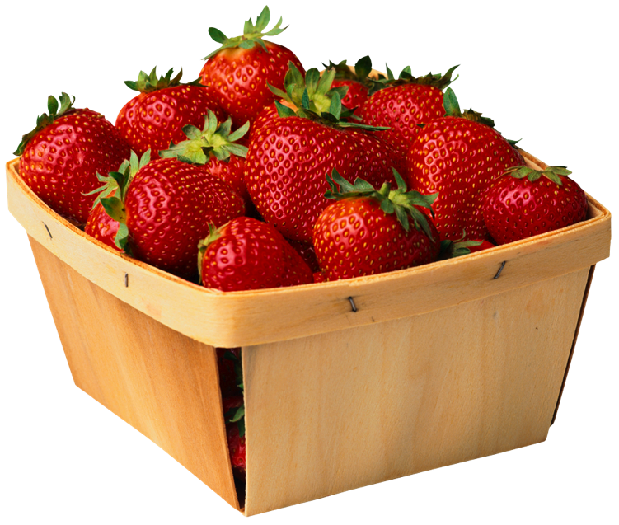
Bearing Fruit As We Walk in Him 我们遵他而行才能结出果实
Who can bear such the fruit? 谁能结这样的果子?
For those who are …
To be rooted and grounded in Christ 在他里面生根建造 (Col. 2:7; Eph. 3:17)
Abiding in Him like vines 常在他里面如枝子 (John 15:4)
Planted by rivers of water 栽在溪水旁 (Psa. 1:3)
Letting the sap of Holly Sprit produces in them. 光明所结的果子就是一切良善、公义、诚实。 (Eph. 5:9)

Slide 6
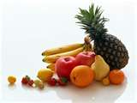
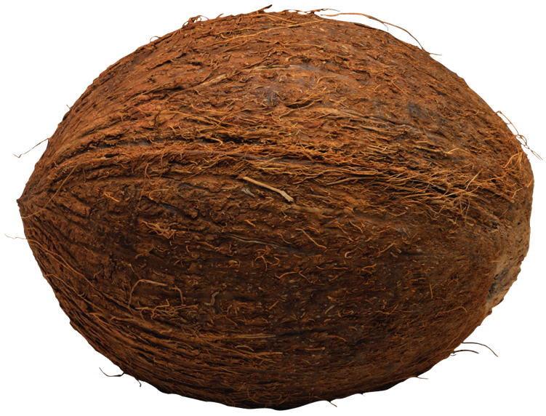
Bearing Fruit As We Walk in Him 我们遵他而行才能结出果实
Why do we need to bear the fruit? 为何我们需要结果子?
“Unto holiness” (Rom. 6:22) 有成圣的果子
“Of righteousness, which are by Jesus Christ to the glory and praise of God” (Phil. 1:11) 并靠着耶稣基督结满了仁义的果子，叫荣耀称赞归与 神。
Stay fresh and flourishing (Psa. 92:14) 要满了汁浆而常发青。

Slide 7
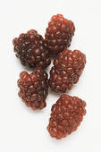
Bearing Fruit As We Walk in Him 我们遵他而行才能结出果实
How can we bear the fruit? (John 15:5; Matt. 5:16; Luke 6:44) 如何我们才能结果子?
Like branches abide in the vine (John 15:5) 枝子常在葡萄树上
“Let your light so shine before men, that they may see your good works and glorify your Father in heaven.” (Matt. 5:16) 你们的光也当这样照在人前，叫他们看见你们的好行为，便将荣耀归给你们在天上的父。
“For every tree is known by its own fruit.” (Luke 6:44) 凡树木看果子，就可以认出他来。

Slide 8
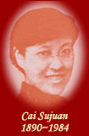
Queen of the Dark Chamber 暗室之后 蔡蘇娟
Cai Sujuan, 暗室之后 蔡蘇娟 (1890-1984), known in the West as Christiana Tsai, was born in Nanjing, the 18th of 24 children of the vice-governor of Jiangsu Province. Despite her luxurious surroundings, Sujuan was a sad, serious girl, and she considered becoming a Buddhist nun. Instead, her fascination with the English language led her to two missionary schools, the first in Nanjing, where Mary Leaman was the principal, and the second in Suzhou. Sujuan entered these schools determined to shut her ears to all discussion of the Gospel, but when a visiting American pastor preached at the Suzhou school, Sujuan attended to listen to his English. His message, Christ, the Light of the World, struck her to the heart, and she believed.
When Sujuans fianc, whom she had met at church, turned away from Christ, Sujuan broke their engagement. In 1930, Sujuan contracted a devastating case of malaria. She was left bedridden, and was so sensitive to light and noise that she was obliged to remain continually in a darkened room. Sujuan thought her painful confinement would bring an end to effective ministry, but her loving Savior was refining her like gold. From her bedside, Sujuan was able to comfort lost and broken souls more effectively than she had from her pinnacle of wealth and accomplishment . . .

Slide 9
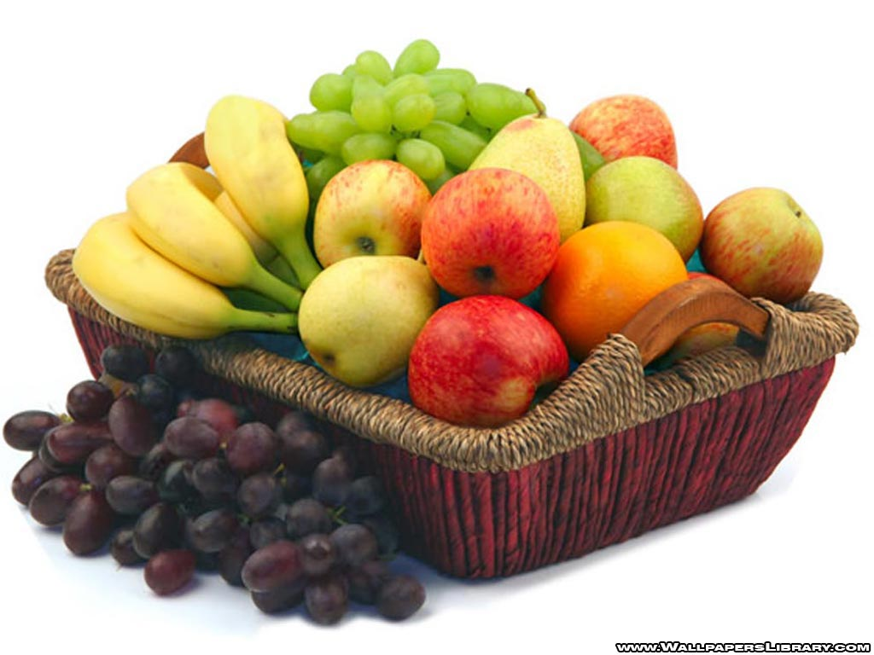
Encouragements/Applications from This Text 经文的鼓励与应用
If we walk in Jesus, our fruit is a gracious gift of God.
如果我们遵主而行, 我们的果子乃是 神的礼物。
Our testimony is the fruit for God’s glory. 我们的见证是 神得着荣耀果子。
We are to produce fruit, more fruit, and much fruit. 我们需要结果子,结果子更多,并且多结果子。
Each fruit of the Spirit has a specific and significant role to display in our Christian life. 各个圣灵的果子都有特定和重要的角色在我们基督徒人生里。
Wherever God places us will be the place where we will present our fruit. 无论在 神放我们在何处,何处就是我们要呈现果子的地方。

