Slide 1
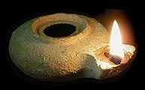
Seeing God‘s Purpose in Our Life
Luke 11:33-36, Matthew 6:22-23, Mark 4:21
Greater Kansas City Chinese Christian Church 堪城华人基督教会
FEB. 26, 2012

Slide 2
Seeing God‘s Purpose in Our Life 腓立比書 Philippians 2:15-16
¹⁵ that you may become blameless and harmless, children of God without fault in the midst of a crooked and perverse generation, among whom you shine as lights in the world, ¹⁶ holding fast the word of life, so that I may rejoice in the day of Christ that I have not run in vain or labored in vain.

Slide 3
This little light of mine
This little light of mine/I'm gonna let it shine
This little light of mine/I'm gonna let it shine
This little light of mine/I'm gonna let it shine
Let it shine/Let it shine/Let it shine
Hide it under a bushel Oh no!/I'm going to let it shine
Hide it under a bushel Oh no!/I'm going to let it shine
Hide it under a bushel Oh no!/I'm going to let it shine
Let it Shine/All the time/Let it shine
Don't let the Satan blow it out/I'm going to let it shine
Don't let the Satan blow it out/I'm going to let it shine
Don't let the Satan blow it out/I'm going to let it shine
Let it Shine/All the time/Let it shine
…

Slide 4
Seeing God‘s Purpose in Our Life
Shining as a lamp (Luke 11:33a)
Not Hidden
¹⁴Ye are the light of the world. A city that is set on an hill cannot be hid. ¹⁵Neither do men light a candle, and put it under a bushel, but on a candlestick; and it giveth light unto all that are in the house. ¹⁶Let your light so shine before men, that they may see your good works, and glorify your Father which is in heaven. (Matt. 5:14-16, KJV)

Slide 5
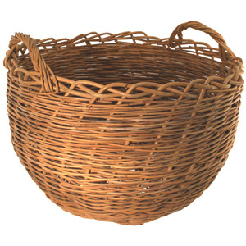
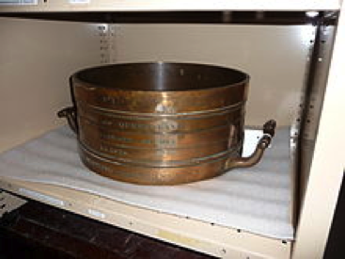
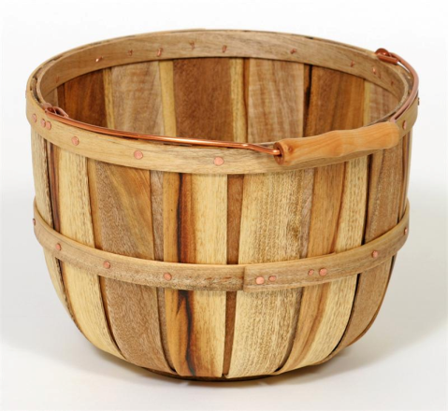
Seeing God‘s Purpose in Our Life
Bushels are now most often used as units of mass or weight rather than of volume. The bushels in which grains are bought and sold on commodity markets or at local grain elevators, and for reports of grain production, are all units of weight. This is done by assigning a standard weight to each commodity that is to be measured in bushels.

Slide 6
Seeing God‘s Purpose in Our Life
Shining as a lamp (Luke 11:33b)
Put on the right place
¹⁶Let your light so shine before men, that they may see your good works, and glorify your Father which is in heaven. (Matt. 5:16, KJV)

Slide 7
Seeing God‘s Purpose in Our Life
Receiving the Light of God (Luke 11:35)
Light of Men
³⁵ Therefore take heed that the light which is in you is not darkness. (Luke 11:35, KJV)
¹² Then Jesus spoke to them again, saying, “I am the light of the world. He who follows Me shall not walk in darkness, but have the light of life.” (John 8:12, NKJV)
⁹That was the true Light which, coming into the world, gives light to every man. (John 1:9 NKJV)

Slide 8
Seeing God‘s Purpose in Our Life
Being Single of Our Eye Sight (Luke 11:34, KJV)
³⁴ The light of the body is the eye: therefore when thine eye is single, thy whole body also is full of light; but when thine eye is evil, thy body also is full of darkness. (Luke 11:34, KJV)

Slide 9
Seeing God‘s Purpose in Our Life
Being Single of Our Eye Sight (Luke 11:34, KJV)
Singleness
Single – Haploos, haplous
i.e. not complex, easy, used of the eye as not seeing double as when it is diseased.
Singleness, simplicity, absence of folds. This, however, does not involve stupidity on the part of Christian, but rather prudence, knowing how to deal with fellow humans and the circumstances of life.

Slide 10
Seeing God‘s Purpose in Our Life
Being Single of Our Eye Sight (Luke 11:34, KJV)
Thus, the Christian is supposed to be not only haplous, single and without duplicity, but also prudent.
¹⁶ “Behold, I send you out as sheep in the midst of wolves. Therefore be wise as serpents and harmless as doves. (Matt. 10:16)
¹⁹ … but I want you to be wise about what is good, and innocent about what is evil. (Rom. 16:19b)

Slide 11
Seeing God‘s Purpose in Our Life
Being Single of Our Eye Sight (Luke 11:34, KJV)
Serving only one master
²²The light of the body is the eye: if therefore thine eye be single, thy whole body shall be full of light. ²³But if thine eye be evil, thy whole body shall be full of darkness. If therefore the light that is in thee be darkness, how great is that darkness! ²⁴No man can serve two masters: for either he will hate the one, and love the other; or else he will hold to the one, and despise the other. Ye cannot serve God and mammon.
(Matt. 6:22-24)

Slide 12
Seeing God‘s Purpose in Our Life
Having no part dark (Luke 11:36, NKJV)
³⁶ If then your whole body is full of light, having no part dark, the whole body will be full of light, as when the bright shining of a lamp gives you light.” (Luke 11:36)
You are all sons of light and sons of the day. We are not of the night nor of darkness. (1 Thessalonians 5:5)
But you are a chosen generation, a royal priesthood, a holy nation, His own special people, that you may proclaim the praises of Him who called you out of darkness into His marvelous light; (1 Peter 2:9)

Slide 13
Seeing God‘s Purpose in Our Life
Having no part dark (Luke 11:36, NKJV)
…God is light and in Him is no darkness at all. (1 John 1:5)
Again, a new commandment I write to you, which thing is true in Him and in you, because the darkness is passing away, and the true light is already shining. (1 John 2:8)
For it is the God who commanded light to shine out of darkness, who has shone in our hearts to give the light of the knowledge of the glory of God in the face of Jesus Christ. (2 Corinthians 4:6)

Slide 14
Daniel praised the God of heaven (Dan. 2:19-23)
²² He reveals deep and secret things;
He knows what is in the darkness,
And light dwells with Him. (Dan. 2:22)

Slide 15
Encouragements/Applications from This Text
Seeing God‘s Purpose in Our Life
A lighted lamp placed under the bushel cannot shine out its light. The believers as a lighted lamp should not be covered by the bushel.
We, the believers, are as luminaries (Phil. 2:15) and the churches as lampstands (Rev. 1:20), shining in this dark age as His testimony, and consummating in the New Jerusalem with the outstanding characteristics of life and light (Rev. 22:1-2; 21:11, 23, 24)
”The light in us, which the eye illuminates (Luke 11:34), is the light in our heart, which should be kept pure for God. (Matt. 5:8)
If we focus our eyes on Him only, our sight will be single and the whole body will be illuminated.

