Slide 1
What Good is Faith?
Having heroic faith in the harsh realities of life
Sunday, April 25, 2012

Slide 2
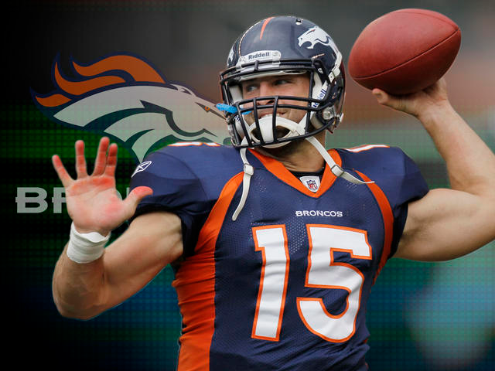

Slide 3
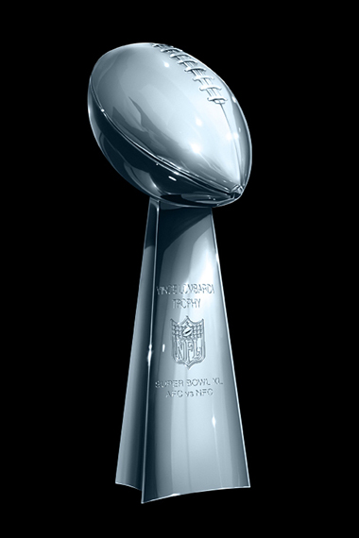
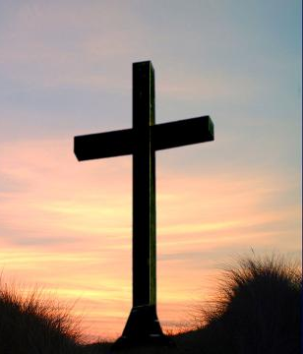

Slide 4
Hebrews 11:39–40 (NIV84) ³⁹ These were all commended for their faith, yet none of them received what had been promised. ⁴⁰ God had planned something better for us so that only together with us would they be made perfect.

Slide 5
We must accept the possibility of Harsh Realities
Faithful heroes may not realize earthly rewards

Slide 6
Hebrews 11:13–16 (NIV84) ¹³ All these people were still living by faith when they died. They did not receive the things promised; they only saw them and welcomed them from a distance. And they admitted that they were aliens and strangers on earth.

Slide 7
Hebrews 11:13–16 (NIV84) ¹⁴ People who say such things show that they are looking for a country of their own. ¹⁵ If they had been thinking of the country they had left, they would have had opportunity to return.

Slide 8
Hebrews 11:13–16 (NIV84) ¹⁶ Instead, they were longing for a better country—a heavenly one. Therefore God is not ashamed to be called their God, for he has prepared a city for them.

Slide 9
Genesis 12:1–3 (NIV84) ¹ The Lord had said to Abram, “Leave your country, your people and your father’s household and go to the land I will show you. ² “I will make you into a great nation and I will bless you; I will make your name great, and you will be a blessing. ³ I will bless those who bless you, and whoever curses you I will curse; and all peoples on earth will be blessed through you.”

Slide 10
We must accept the possibility of Harsh Realities
Faithful heroes may not realize earthly rewards

Slide 11
We must accept the possibility of Harsh Realities
Faithful heroes may not realize earthly rewards
Faithful heroes may realize earthly suffering

Slide 12
Hebrews 11:35–38 (NIV84) ³⁵ …Others were tortured and refused to be released, so that they might gain a better resurrection. ³⁶ Some faced jeers and flogging, while still others were chained and put in prison.

Slide 13
Hebrews 11:35–38 (NIV84) ³⁷ They were stoned; they were sawed in two; they were put to death by the sword. They went about in sheepskins and goatskins, destitute, persecuted and mistreated— ³⁸ the world was not worthy of them. They wandered in deserts and mountains, and in caves and holes in the ground.

Slide 14
Hebrews 11:4 (NIV84) ⁴ By faith Abel offered God a better sacrifice than Cain did. By faith he was commended as a righteous man, when God spoke well of his offerings. And by faith he still speaks, even though he is dead.

Slide 15


Slide 16
We must accept the possibility of Harsh Realities
Faithful heroes may not realize earthly rewards
Faithful heroes may realize earthly suffering

Slide 17
Let us persevere with Heroic Faith by…
Believing that God exists

Slide 18
Hebrews 11:6 (NIV84) ⁶ And without faith it is impossible to please God, because anyone who comes to him must believe that he exists and that he rewards those who earnestly seek him.

Slide 19
Let us persevere with Heroic Faith by…
Believing that God exists

Slide 20
Let us persevere with Heroic Faith by…
Believing that God exists
Believing that God will reward in the future

Slide 21
Hebrews 11:6 (NIV84) ⁶ And without faith it is impossible to please God, because anyone who comes to him must believe that he exists and that he rewards those who earnestly seek him.

Slide 22
Let us persevere with Heroic Faith by…
Believing that God exists
Believing that God will reward in the future
  Heavenly rewards

Slide 23
Heavenly Rewards
New bodies and minds (1 Corinthians 15)
Presence of God (Revelation 21)
With Jesus in paradise (Luke 23)
Justice for evildoers and scoffers (2 Peter 2-3)
Infinite peace and joy (Revelation 21)
Heavenly “crowns” (2 Tim 4; James 1)

Slide 24
Let us persevere with Heroic Faith by…
Believing that God exists
Believing that God will reward in the future
  Heavenly rewards
  Earthly blessings on future generations

Slide 25
John 12:23–24 (NIV84) ²³ Jesus replied, “The hour has come for the Son of Man to be glorified. ²⁴ I tell you the truth, unless a kernel of wheat falls to the ground and dies, it remains only a single seed. But if it dies, it produces many seeds.

Slide 26

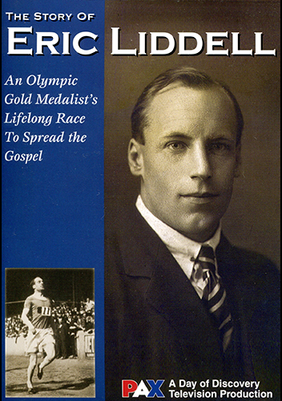

Slide 27
We can persevere with Heroic Faith by…
Believing that God exists
Believing that God will reward in the future
  Heavenly rewards
  Earthly blessings on future generations

Slide 28
Let us persevere with Heroic Faith by…
Believing that God exists
Believing that God will reward in the future
  Heavenly rewards
  Earthly blessings on future generations
Keeping our eyes on Jesus

Slide 29
Hebrews 11:39–40 (NIV84) ³⁹ These were all commended for their faith, yet none of them received what had been promised. ⁴⁰ God had planned something better for us so that only together with us would they be made perfect.

Slide 30
Hebrews 12:1–3 (NIV84) ¹ Therefore, since we are surrounded by such a great cloud of witnesses, let us throw off everything that hinders and the sin that so easily entangles, and let us run with perseverance the race marked out for us.

Slide 31
Hebrews 12:1–3 (NIV84) ² Let us fix our eyes on Jesus, the author and perfecter of our faith, who for the joy set before him endured the cross, scorning its shame, and sat down at the right hand of the throne of God. ³ Consider him who endured such opposition from sinful men, so that you will not grow weary and lose heart.

Slide 32
We must accept the possibility of Harsh Realities
Faithful heroes may not realize earthly rewards
Faithful heroes may realize earthly suffering

Slide 33
Let us persevere with Heroic Faith by…
Believing that God exists
Believing that God will reward in the future
  Heavenly rewards
  Earthly blessings on future generations
Keeping our eyes on Jesus

